Slide 1
Dr. F.Arteche
Instituto Tecnológico de Aragón (ITA)
Belle II:
Grounding and Electronics Integration Issues

Slide 2
OUTLINE
1. Introduction – Belle II environment
2. Grounding effects on the system
3. Noise susceptibility levels coordination
4.Noise emission levels coordination
5. Cabling coordination
6. DEPFET PXD – EMC plan
7. Conclusions

Slide 3
1. Introduction – Belle II experiment
CsI EM calorimeter:
RPC μ & K_{L} counter: scintillator + Si-PM (for end-caps)
Solenoid
SVD (Silicon Vertex Detector)
PXD (DEPFET),
PI barrel / Endcap
TOP+A-RICH
Central Drift Chamber

Slide 4
1. Introduction – Belle II environment
STM 1
LV few V
HV – V
STM 1 & 2
LV – A
HV - mA
Slow control
Distribution
Bus
Transients
Radiation
Noise
Conductive
Noise
Harmonics
&
Conductive noise
FEE1 (dc)
PS1
Radiation
Noise
Radiation
Noise
Radiation
Noise
PS2
FEE2 (dc)
Conductive
Noise
Radiation
Noise
Radiation
Noise
Conductive
Noise
STM 2
LV 5-10 V
HV - kV
Slow control
HEP experiment EMC map
Shielding

Slide 5
1. Introduction – Belle II environment
The integration of the electronic systems has to be carried out in two phases:
  Grounding and shielding
  EMC characterization of the experiment
    EM susceptibility and emissions of sub-detectors.
They are focused on control interactions between sub-systems
There are several options to perform the electronics integration
  All may be correct but…they have to be coordinated
    Different strategies between subsystems may lead to serious problems.
  Belle II is a system – not group of independent systems

Slide 6
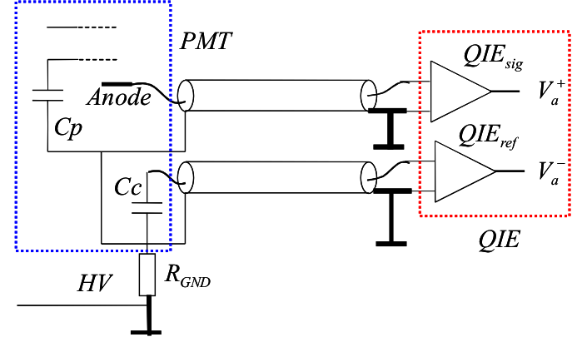
2. Grounding effects on the system
GND1
GND2
GND3
-
+
The selection and definition of the grounding topology has an important impact in the electronics sensitivity
  Design should involve electrical & mechanical engineering issues.
Study of the connection between detector & electronics
  GND1 – GND connection between PMT & FE amplifier
  GND2 – GND connection between HV & LV
  GND3 – GND between power lines and MBox of FEE

Slide 7
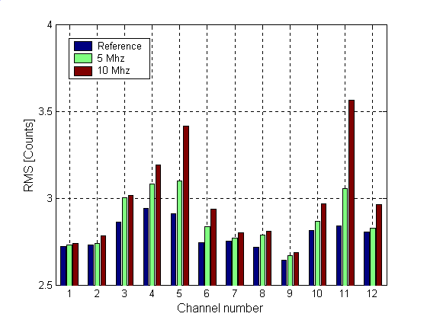
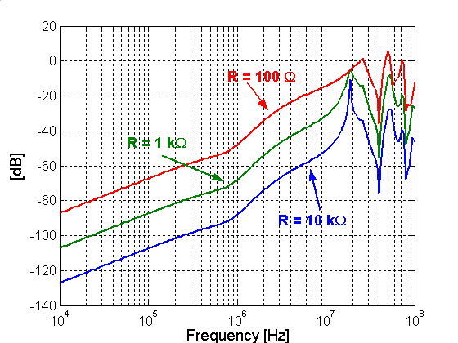
2. Grounding effects on the system
Gnd1
Gnd2
GND 1 – Ground connection PMT – Board ( Noise currents)
  It has an impact in noise distribution (connection, mechanical layout )
GND 2 – Ground connection HV – LV ( rejection )
  It has an impact in noise distribution & safety issues
Notes:
In terms of disgnosis ...

Slide 8
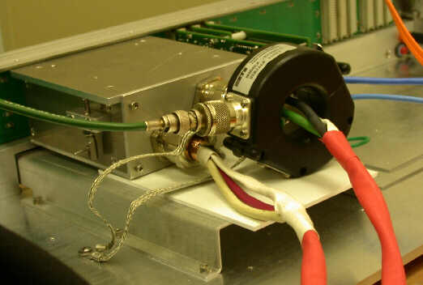
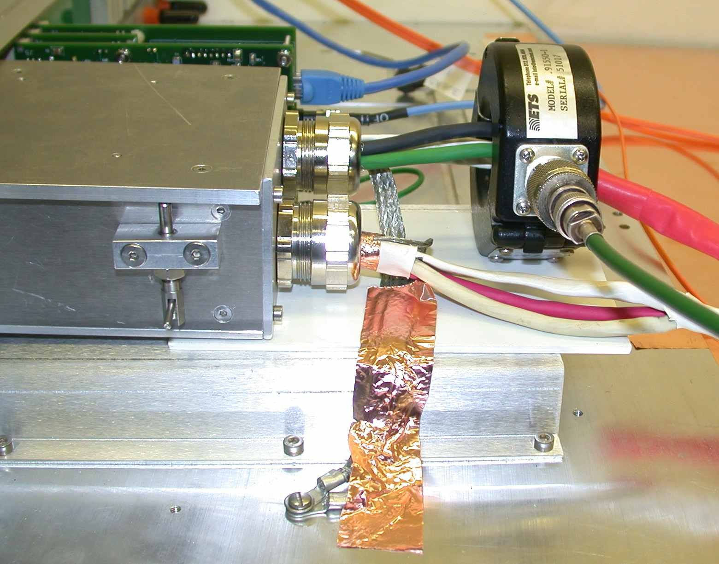
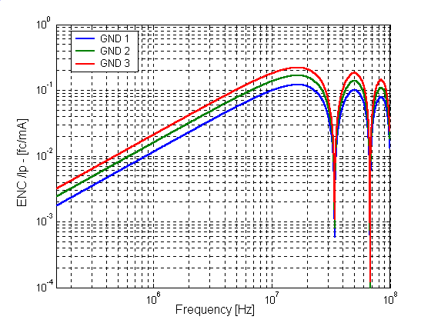
2. Grounding effects on the system
GND 3
  Safety issues define the GND3 connection
    Faults
  Definition of GND point.
    Mechanic topology has strong impact
Gnd3

Slide 9
3 Noise susceptibility levels coordination
Previous analysis shows the grounding design has an important impact in the susceptibility level of the any sub-system to electromagnetic noise.
This level has to be characterized and coordinated with other sub-systems to evaluate the integration options .
  It will define the susceptibility level of the experiment.
    If one sub-system fails the experiment fails.
It will help to define weak points and take the corrective actions during the design phase.
  It saves time and …money
Lets consider as example CMS…..

Slide 10
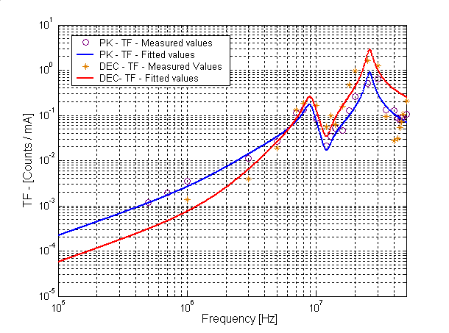
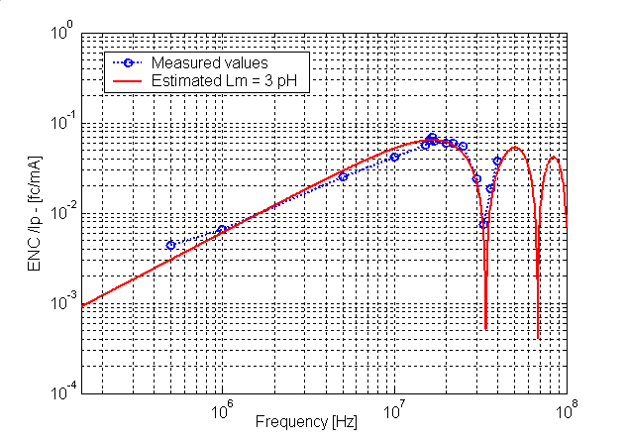
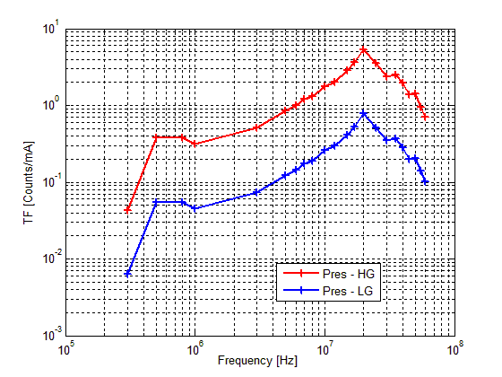
3. Noise susceptibility levels coordination.
HCAL
Tracker
Susceptibility levels to conducted noise
Remark:
  The FEE is very sensitive at high frequency, above the amplifier bandwidth
    The noise coupling path is important at HF.
Pre-shower

Slide 11
3. Noise susceptibility levels coordination.
The pre-shower FEE system showed poor results but they were in early stage of the design
  Corrective action were implemented…
    New filtering.
Allowed to identify the system that needed to improve the design

Slide 12
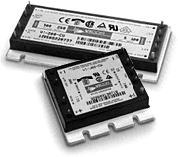
4. Noise emission level coordination.
One of the most important noise sources in HEP are the switching power supplies.
They have EM emissions
  Radiated
  Conducted Emissions
Frequency range
  Conducted emissions – few kHz up to MHz
  Radiated emissions –MHz up to 1 GHz
The spectra content is very close related to :
  Switching frequency
  Topology
The emissions level of the power supply has to be coordinated:
  Sub-detector level
  Experiment level

Slide 13
4. Noise emission level coordination.
PS1
PS2
HS - Electroncis
ZCS
All levels are compatible to its systems
But they may be not compatible among them.
  Different spectra content
PS3
Hard switching
  HF higher
PS Electronics
  Increases noise
HS

Slide 14
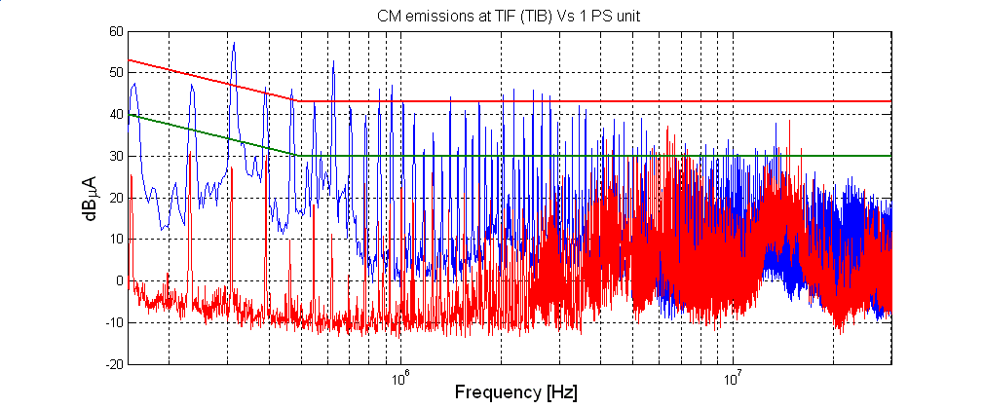
4. Noise emission level coordination.
Several power supplies increases the noises
  Test on simple units may not guarantee the performance of final system and experiment
  It is necessary to define a safety margin between emission and susceptibility levels.
PS2 (1 unit Vs 50 units)

Slide 15
5. Cabling coordination
Belle II and any HEP experiment have a large amount of cables installed in a small volume.
These cables are very different
  Voltages - LV (V ) to HV (kV)
  Currents - Low currents (ma) to High Currents (several amps)
  Signal & power
Attention should be paid in the cabling coordination because it may lead to some integration problems .
  Interference phenomena
    High frequency
  Transient effect
    Low frequency phenomena – Destructive effects

Slide 16
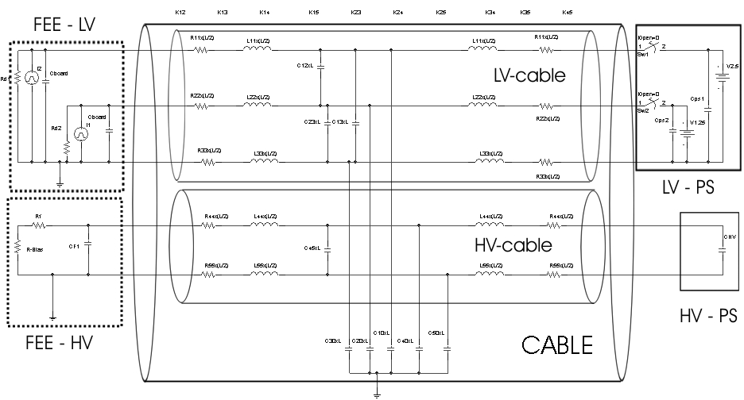
5. Cabling coordination
A transient phenomena in HV line may generate a transient in the LV
  Short circuit in HV lines – High current
  The HV capacitor is discharged
    HV PS reacts fast

Slide 17
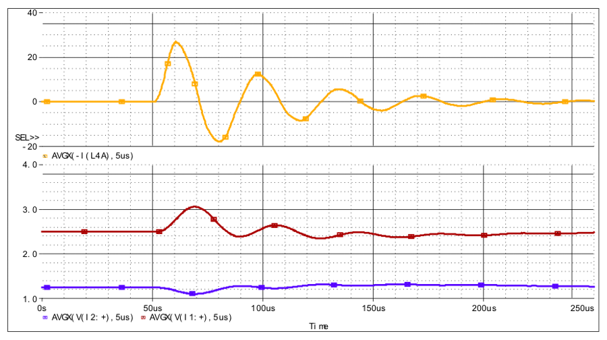
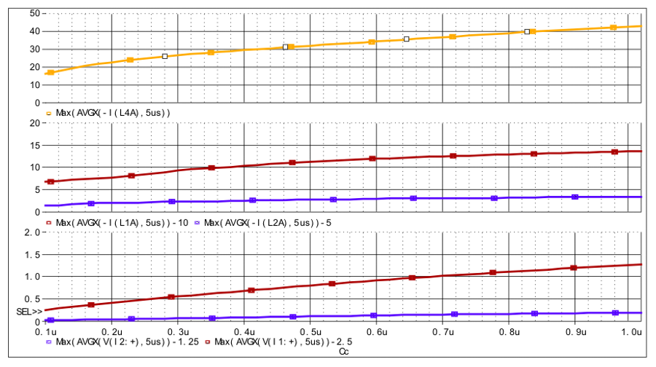
5. Noise compatibility - Cabling
A Pspice simulation shows an overvoltage in the LV line.
  LV-PS cannot attenuates this transient
Transient energy depends on :
  Design parameters – HV capacitor & LV protection
  Cabling integration – Cable layout and organization (power levels)
This is a simulation but during a RAD test of power system we observed this effect.

Slide 18
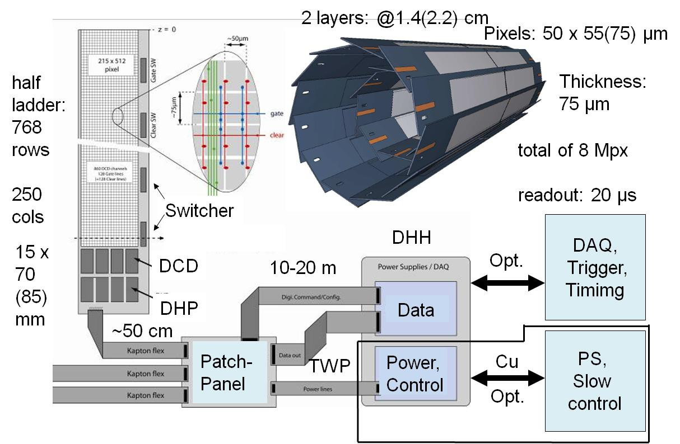
6. DEPFET PXD – EMC plan
FEE (Sensor, DCD,DHP,DHH)
  It may be sensitive to EM noise
  It may radiates ( HF clocks and signals)
Power supplies
  It emits EM noise
Cable & connectors
  It may propagate EM noise inside/outside FEE area
The design of the DEPFET detector will address the control of EMI phenomena

Slide 19
6. DEPFET PXD – EMC plan
An EMC project proposal has been approved
The main goal of the project is to ensure the correct performance of PXD system.
  Ensure the compatibility of DEPFET.
  We will try to ensure the performance of DEPFET in Belle II
    But...It will deepens on other sub-system too
The EMC project has 4 WPs
Compatibility
Compatibility
Compatibility
SUB1
SUB2

Slide 20
6. DEPFET PXD – EMC plan
  WP1: Grounding and shielding strategy for DEPFET: Coordination & Policy
  It is focused on grounding and shielding aspects.
It plans to define:
  Safety grounding
  Signal or ground reference plane
  Grounding topologies
These issues will be used to verify:
  Electrical safety issues
  Identify possible ground loops
  Identify EMI sources
  Identify EMI victims

Slide 21
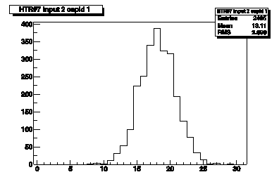
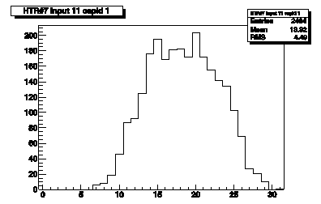

6. DEPFET PXD – EMC plan
  WP2: Immunity issues of DEPFET FEE: Susceptibility curves of DEPFET system.
The main goal is to define the susceptibility level of DEPFET FEE to
  EM perturbation
A set of test will be performed in an EMC unit
No
noise
Noise

Slide 22
6. DEPFET PXD – EMC plan
WP3: Noise emissions of PS units
  The main goal of this WP is to measure the noise emission level of the power supply units
  It will help to define the compatible levels with the FEE.
  They are complementary to those performed in WP2
WP4: Noise propagation issues
  The main goal of this WP is to define the key parameters and the configuration of the power distribution network to minimize the conducted noise.
  It will help to addresses the effect of power cables on:
    the noise propagation
    the impact that those cables have in the selection of:
      EMI filters for the FEE low-voltage input
      PS Noise emission levels acceptance

Slide 23
6. CONCLUSIONS
The electronics integration activities are important to ensure the correct performance of any HEP
The electronics integration of HEP experiment is defined by Grounding and shielding issues
  They will define the emission and susceptibility of any system to EM noise
    Front-end Electronics susceptibility
    Emission of electronic equipment
The coordination of these items is very important to ensure the correct performance of the experiment
  An small and well coordinated team is the best option
    One experienced person per sub-detector
    They have to take decisions, coordinate, fix noise level and responsibilities
DEPFET has considered seriously these studies and has defined a detailed plan

Slide 24
Acknowledgements
Stanford Linear Accelerator , SLAC (USA)
  Dr. Claudio Rivetta
Instituto Tecnológico de Aragón, ITA (Spain)
  Dr. J.L. Pelegay (Head R&D division)
  C. Esteban and EMC group
Max-Planck-Institut für Physik, MPP (Germany)
  Prof. Christian Kiesling
  Dr. Hans-Günther
Instituto de Física de Cantabria, IFCA (Spain)
  Dr. I.Vila

Slide 25
5. Conclusions - References
DC-DC converters
F. Arteche et Al. "DC-DC switching converter based power distribution vs serial power distribution : EMC strategies" TWEPP-09: Topical Workshop on Electronics for Particle Physics, Paris, France, 21 - 25 Sep 2009, pp.384-389.
F. Arteche, C. Rivetta, "EMI Filter Design and Stability Assessment of DC Voltage Distribution based on Switching Converters" Proc. 7th Workshop on Electronics for LHC experiments, LECC 2001. Stockholm,(Sweden) pp 353-357, September 2001
A. Nagrial, M.H.; Hellany, “Radiated and conducted EMI emissions in switch mode power supplies (SMPS): sources, causes and predictions”, Proceedings of IEEE International Conference, 2001. IEEE INMIC 2001, 28-30 Dec. 2001 Page(s):54-61
Hardin, K.; McClure, G.; Menke, R. ”Methods for identifying causes of EMI emissions from switched mode power applications”, 2001. EMC. 2001 IEEE International Symposium on Electromagnetic Compatibility, Volume 2, 13-17 Aug. 2001 Page(s):1092 – 1096
Noise propagation
C.R. Paul." Analysis of multi-conductor transmission lines ", 1992, ISBN-0-471-02080-X
Lorenz-Jung, Jan Luiken ter Haseborg " Evaluation of measured complex transfer admittance for the characterization of shield in-homogeneities of Multi-conductor Cables ", IEEE Trans. on Electromagnetic Compatibility vol. 41 No 4 - Nov.1999
F. Arteche, C. Rivetta, "Noise Susceptibility Analysis of the HF Front-End Electronics for the CMS High -Energy Experiment". Proc. IEEE Int. Symposium on EMC, Boston (USA), Vol 2, pp 718-723, Aug 2003.
F. Arteche, C. Rivetta, "Effects of CM and DM noise propagation in LV distribution cables" Proc. 9th Workshop on Electronics for LHC experiments, LECC2003. Amsterdam (Netherlands) pp 380-385, October 2003
Noise immunity test & EMC Topologies
F.Arteche et Al. “Detector noise susceptibility issues for the future generation of High Energy Physics Experiments”, Topical Workshop on Electronics for Particle Physics, Naxos, Greece,Sep 2008, pp.533-538
6100-5-2 IEC: EMC part 5 : Installation and mitigation guide line. Section 2: Earthing and cabling
MIL-STD-461: Requirements for the control of EMI characteristics of sub-systems and equipment
NASA: Marshall Space Flight Centre Electromagnetic Compatibility Design and Interference Control Handbook
F. Arteche & C. Rivetta, “EM Immunity studies for front-end electronics in high-energy physics experiments “, International Symposium on EMC - EMC Europe 2004 - Eindhoven, The Netherlands - September 2004
F. Arteche & C. Rivetta , “EMC studies in High Energy Physics experiments”, European Space Agency EMC Conference - Noordwijk, The Netherlands - February 2004

Slide 26
THANK YOU
FOR
YOUR ATENTION

