Slide 1
F. Arteche
EMC: Electronics system integration for HEP experiments
(Grounding & Shielding)

Slide 2
OUTLINE
1. EMC integration strategy
2. Grounding
3. Block diagram (EMC map)
4. EMC unit analysis
  Noise emissions
  Noise immunity
  Coupling path
    Cabling coordination
5. Conclusions

Slide 3
1. EMC integration strategy
The main goal is to ensure the correct performance of HEP detectors or experiments.
  Ensure the compatibility in each sub-system
  Ensure the compatibility among units – sub-systems
    It establishes a safety margin
EMC integration strategy is carried out in three stages:
  Grounding issues (strategy)
  Block diagram (EMC map)
  EMC unit analysis
Compatibility
Compatibility
Compatibility
SUB1
SUB2

Slide 4
1. EMC integration strategy
It applies TOP-BOTTON-BOTTON-TOP approach
  Detector-Sub-system-EMC unit
  EMC unit identification
    Minimum unit that represents each sub- system
EMC unit analysis is carried out by
  Identification & evaluation of noise sources
  Identification & evaluation of noise immunity at FEE level
  Identification & evaluation of coupling paths
The identification & evaluation are based on :
  Standardized measurements
  Non- standardized measurements
  Electromagnetic models (simulation)

Slide 5
2. Grounding
What is a ground ?
  It is a reference
    Uniform reference voltage at any frequency
  It is a structure to bypass currents
    Fault (short circuits ..)
    Noise
Reasons for Grounding
  Safety
  Equipment protection
  Equipment performance
Golden rule:
  “Make the system safe and then make it work ”

Slide 6
2. Grounding
Recommendation for good grounding designs:
  Selection of reference structure ( grid 3D or plane)
    Detector & Experiment level
  Safety ground & equipment protection
    Laboratory codes and standards.
  Ground designs to improve the equipment performance
    At LF – Avoid ground loops
    At HF – Avoid noise currents pass through sensitive parts
  All experiment subsystems have to present the same ground topology.
    They have to be coordinated

Slide 7
2. Grounding
Experiment level

Slide 8
2. Grounding
System level
Courtesy :
Dr. Rivetta (SLAC)
Global & System grounding policy have to be coordinated

Slide 9
3. Block diagram (EMC map)
The block diagram is used to :
    Identify sub-systems
    Power levels
    Noise sources and victims
    Coupling phenomena
It helps to define the EMC unit
    All studies and analysis will be focused on this unit to ensure the correct electronics integration

Slide 10
3. Block diagram (EMC map)
Tracker
2.5V, 1.25 V
500 V
Slow control
Transients
Radiation
Noise
Distribution
Bus (AC)
Conductive
Noise
AC-DC
SMPS
FEE (dc)
Harmonics
Radiation
Noise
Radiation
Noise
Radiation
Noise
AC-DC
SMPS
FEE (dc)
Conductive
Noise
Radiation
Noise
Radiation
Noise
Conductive
Noise
HCAL
6.5 V, 4.5V
7 kV
Slow control
CMS EMC map – Block diagram
Shielding

Slide 11
4. EMC unit analysis
HEP experiments are very complex
    The idea is to define general rules emerging from particular sub-systems (TOP-BOTTON-BOTTON-TOP approach)
HEP sub-detectors can be considered as isolated system
  Power Supply & Slow control system only galvanic connection.
A reduced model of the sub-system is considered for EMC study of HEP experiment
  Noise sources – PS
  Coupling path - Cables
  Victim - FEE
Victim
P.S.
Voltage Distribution
P.S.
FEE
FEE
Detector
Detector
Noise source
Optical Link
Coupling path
Optical Link

Slide 12
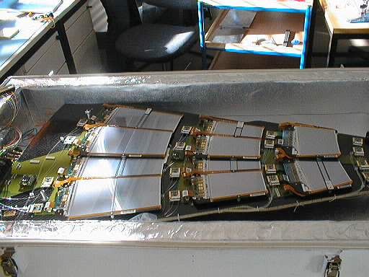
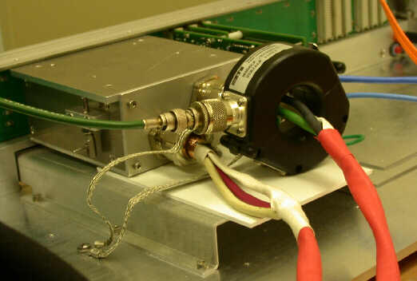
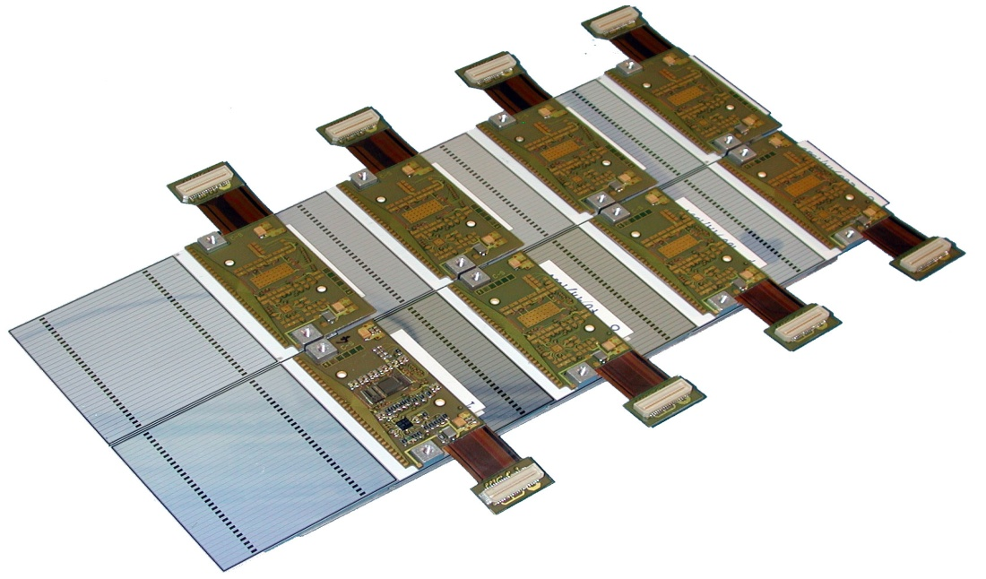
4. EMC unit analysis
HCAL EMC FEE unit – 1 RBX
  Two boards connected
  PCB
Preshower FEE unit – 1 Leader
  7 Modules
TEC FEE unit – 1 Petal
  Petal divided in
    Rings & Modules (16)
  ICB- Inter Circuit Board

Slide 13
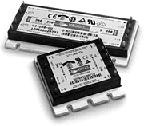
4.1 EMC unit analysis: Noise emissions
One of the most important noise sources in HEP are the switching power supplies.
They have EM emissions
  Radiated
  Conducted Emissions
Frequency range
  Conducted emissions – few kHz up to MHz
  Radiated emissions –MHz up to 1 GHz
The spectra content is very close related to :
  Switching frequency
  Topology
The emissions level of the power supply has to be coordinated:
  Sub-detector level
  Experiment level

Slide 14
4.1 EMC unit analysis: Noise emissions
PS1
PS2
HS - Electroncis
ZCS
All levels are compatible to its system
But they may be not compatible among them.
  Different spectra content
PS3
Hard switching
  HF higher
PS Electronics
  Increases noise
HS

Slide 15
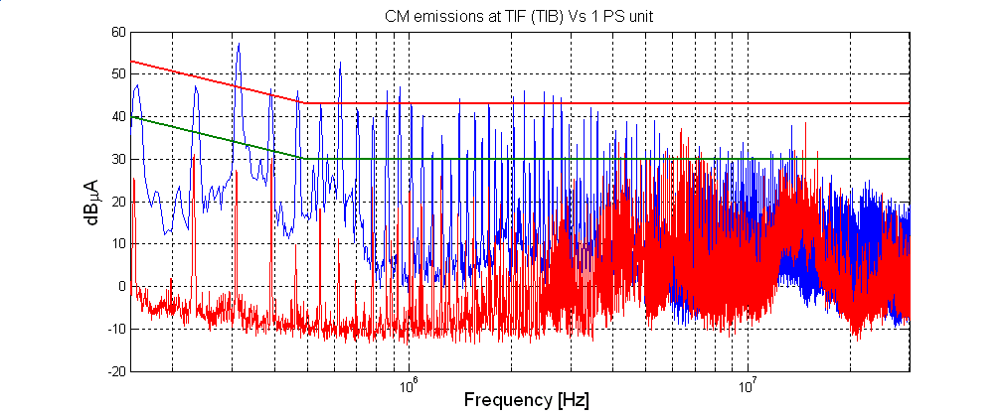
4.1 EMC unit analysis: Noise emissions
Several power supplies increase the noises
  Test on simple units may not guarantee the performance of final system and experiment
  It is necessary to define a safety margin between emission and susceptibility levels.
PS2 (1 unit Vs 50 units)
This is not the only noise source.
  Beam pipe & other sub-detectors

Slide 16
4.2 EMC unit analysis: Noise immunity
But ..Are the PS noise emissions (or other) compatible with the FEE ??
  Do we have enough safety margin ?
Noise sources that deteriorates the FEE performance are:
  Intrinsic thermal noise
  EM noise picked-up by the connection detector - FEE
  EM noise picked-up by the connection FEE - Power supply
This noise defines the minimum signal level that the FEE can process – Thermal noise dominant effect
  Design – Minimize Thermal noise
  Characterize the EMI contributions and decrease its effects
The characterization of EMI contributions may be carried out via :
  Modeling and simulation of system
  Immunity tests on prototypes

Slide 17
4.2 EMC unit analysis: Immunity- Test
The main goal is to define the immunity of the FEE to RF disturbances
  Diagnosis
  Detection of sensitive areas
  FEE frequency response to noise
  Evaluate solutions
  Noise emission specification from PS
Inject a perturbing signal to the FEE and evaluate the FEE performance
  Frequency range (kHz up to 50 MHz or more)
  Test layout ( EMC unit) as similar as possible to the final configuration
Many test configurations may be studied
  Shield currents
  CM and DM currents – Power lines & slow control lines
Test performed on the FEE: EMC unit
FEE
FEE
FEE

Slide 18
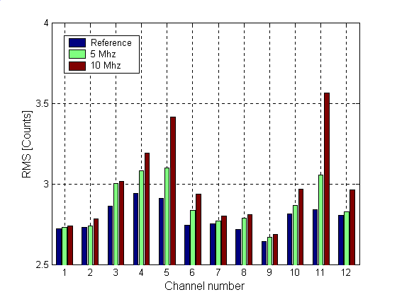
4.2 EMC unit analysis: Immunity- Test
HCAL
Pre-shower
Diagnosis & Sensitive areas
  HCAL – Ground connection photodiodes-Board
  Pre-shower - Ground connections between paths
Notes:
In terms of disgnosis ...

Slide 19
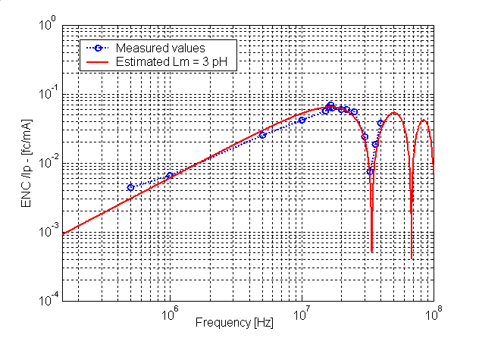
4.2 EMC unit analysis: Immunity- Test
Frequency response
  It is the noise transfer function (TF) of FEE
    To quantify the sensibility of the FEE to noise currents
Icm
External Noise
TF
Vout (RMS)
The FEE is very sensitive at high frequency, above the amplifier bandwidth
  The noise coupling path is important at HF.

Slide 20
4.2 EMC unit analysis: Immunity- Test
FEE susceptibility level coordination:
  The pre-shower FEE system showed poor results but they were in early stage of the design
    Corrective action were implemented (New filtering)
  Allowed to identify the system that needed to improve the design

Slide 21
4.3 EMC unit analysis: Coupling path
Any HEP experiment have a large amount of cables installed in a small volume.
These cables are very different
  Voltages - LV (V ) to HV (kV)
  Currents - Low currents (ma) to High Currents (several amps)
  Signal & power
Attention should be paid in the cabling coordination because it may lead to some integration problems .
  Interference phenomena
    High frequency
  Transient effect
    Low frequency phenomena – Destructive effects
The coupling path analysis can be carried out using:
  Numerical simulation programs
  Real measurements

Slide 22
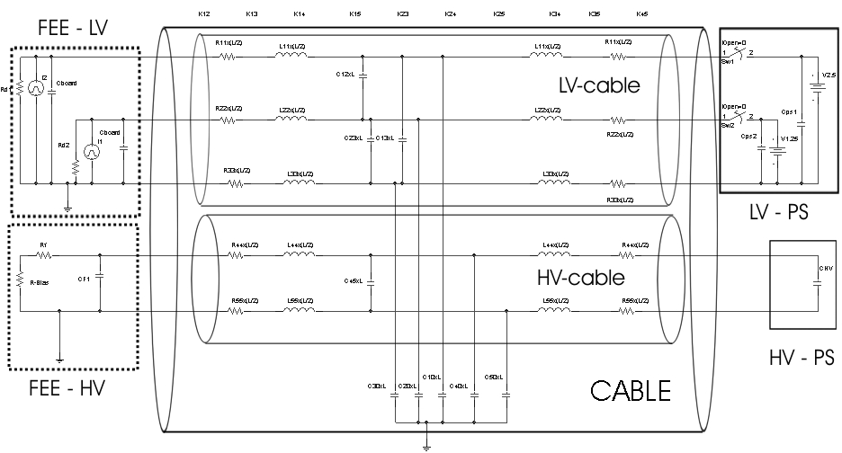
4.3 EMC unit analysis: Coupling path
A transient phenomena in HV line may generate a transient in the LV
  Short circuit in HV lines – High current
  The HV capacitor is discharged
    HV PS reacts fast

Slide 23
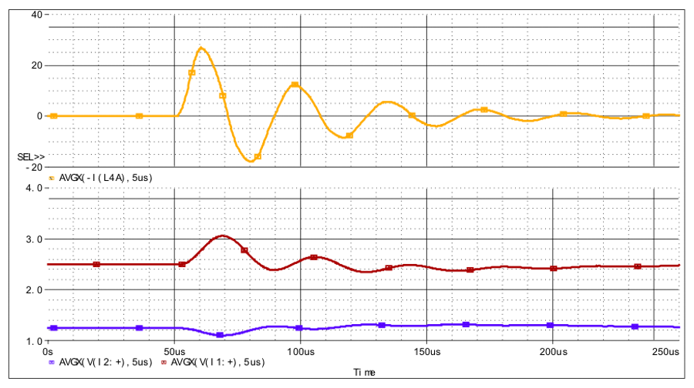
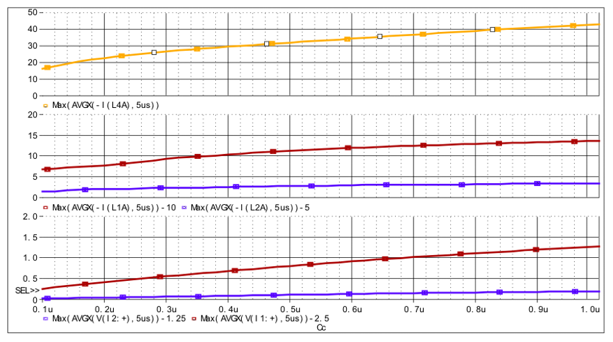
4.3 EMC unit analysis: Coupling path
A Pspice simulation shows an overvoltage in the LV line.
  LV-PS cannot attenuates this transient
Transient energy depends on :
  Design parameters – HV capacitor & LV protection
  Cabling integration – Cable layout and organization (power levels)
This is a simulation but during a RAD test of power system we observed this effect.

Slide 24
5. CONCLUSIONS
The electronics integration activities are important to ensure the correct performance of any HEP
The electronics integration of HEP experiment is defined by grounding and shielding issues
  They will define the emission and susceptibility of any system to EM noise
    Front-end Electronics susceptibility
    Emission of electronic equipment
The coordination of these items is very important to ensure the correct performance of the experiment
  An small and well coordinated team is the best option
    One experienced person per sub-detector
    They have to take decisions, coordinate, fix noise level and responsibilities

