Slide 1

EMC issues for cabling and racks layout design.
(Belle II – Grounding)
F.Arteche

Slide 2
Outline
1.Introduction
2.Cables
3.Racks
4.Future plans for grounding
5.Conclusions

Slide 3
1. Introduction
Complex EM enviroment
CsI EM calorimeter:
RPC μ & K_{L} counter: scintillator + Si-PM (for end-caps)
Solenoid
SVD (Silicon Vertex Detector)
PXD (DEPFET),
PI barrel / Endcap
TOP+A-RICH
Central Drift Chamber

Slide 4
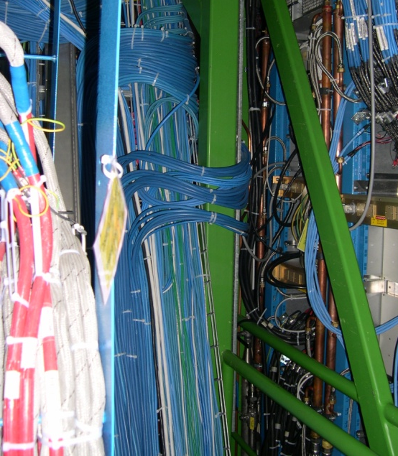
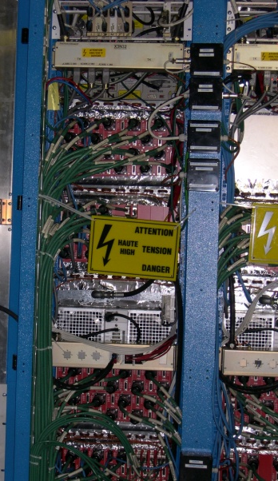
1. Introduction

Slide 5
1. Introduction
There are two elements that play an important role in the electromagnetic noise level of any experiment:
  Cables
  Racks
They may generated many EMC problems:
  Cable radiation
  Cable susceptibility
  Malfunctions due to high electronics density
The EMC effects of this type of elements may be decreased by design ( layout and connectivity)
  It is only a recommendation (where is possible)

Slide 6
2. Cables
Cables may be classified based on EMC cable category
  Class 1 is for cables carrying very sensitive signals.
    C1A - Low-level analogue signals such as millivolt output transducers and radio receiver antennae.
    C1B - High-rate digital communications.
  Class 2 is for cables carrying slightly sensitive signals,
    Ordinary analogue (e.g. 4-20mA, 0-10V, and signals under 1MHz), low-rate digital communications (e.g. RS422, RS485), and digital inputs and outputs (e.g. limit switches, encoders, control signals).
  Class 3 is for cables carrying slightly interfering signals
    Low voltage AC distribution (< 1kV) or DC power (e.g. 48V telecomm's power), where these do not also power 'noisy' apparatus.
  Class 4 is for cables carrying strongly interfering signals.
    This includes all the power inputs or outputs (to or from) adjustable motor drives, power converters; and their DC links, RF equipment.

Slide 7
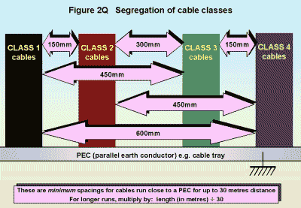
2. Cables
Cables of different EMC categories should be laid separately wherever possible

Slide 8
2. Cables
In case where minimum distance among cables in different categories cannot be obtained, cables may be separated by:
  metallic sheets , cable ducts, screens
The feed and return cables of a circuit shall be laid together.
  Power cables and sensitive signal cables
Cables should run as close as possible to conductive detector structure – minimize ground currents effects

Slide 9
2. Cables
Corner areas of open cables conduits are the best areas against EMI phenomena
  Close conduits are the best option
Free conductors (or shields) must be connected to ground structure
No minimum distance is required in the case of intersection at right angle

Slide 10
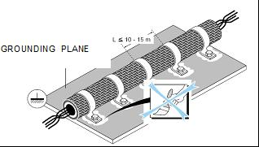
2. Cables
In case screening cables are used, the screen should be well connected to reference plane or to metallic cage.
TYPE OF FIELD | RANGE OF FREQUENCY | EFFECTS WHEN ONE END OF THE SCREEN IS EARTHED | EFFECTS WHEN AT LEAST BOTH ENDS OF THE SCREEN ARE EARTHED
Electrical Field E | f<1 MHz | Good | Good
Electrical Field E | f>1 MHz | Almost no shielding effects | Good
Magnetic Field H | f<1 MHz | Almost no shielding effects | Bad
Magnetic Field H | f>1 MHz | Almost no shielding effects | Good

Slide 11
3. Racks
Racks layout design may improve system performance against EMI phenomena
The most important elements that play an important role in rack (cabinet) noise issues are:
  Reference plane or structure
  Cable routing inside the rack
  Equipment distribution
  Rack grounding and shielding connection.
REFERENCE PLANE
  It helps to control EMC phenomena associate to local PS, filtering and electronics.
  Walls or rack doors may used as REF. plane

Slide 12
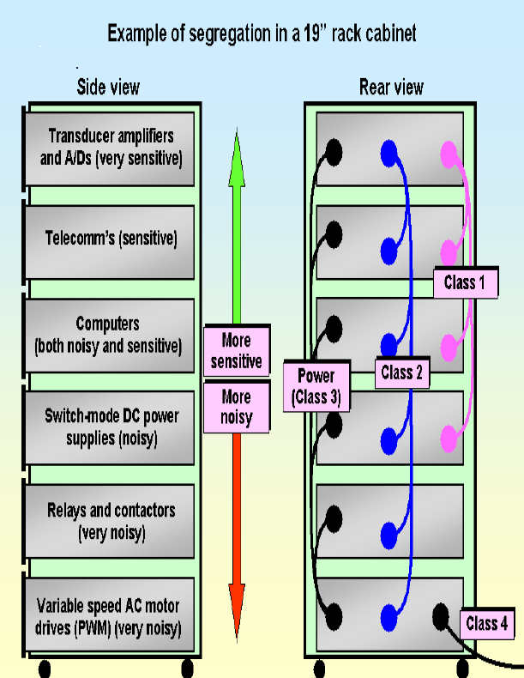
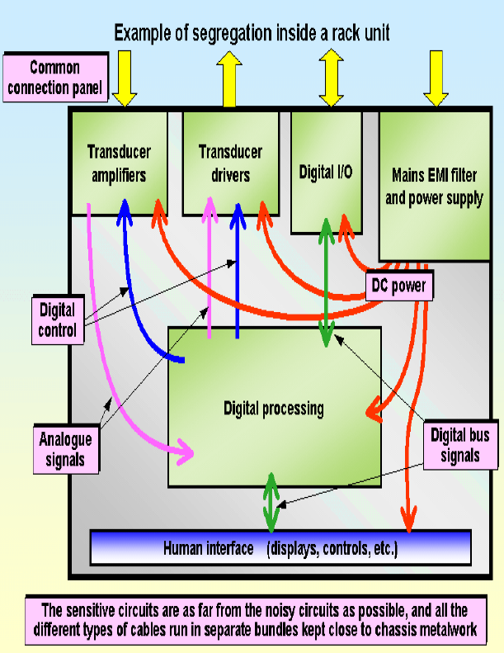
3. Racks
Rack layout is important - Example
Rack
Rack unit

Slide 13
3. Racks
Inside rack cabinets cables may be split in 4 categories:
  A - Power lines (DC-DC mainly)
  B - LV ac lines (power mains),relays, contactors,..
  C2- Sensitive power and electronics, low digital communications
  C1- Sensitive lines (analogue signals, output transducers , Ethernet cables, high rate communications)
It is recommended to keep certain distance among cables categories.

Slide 14
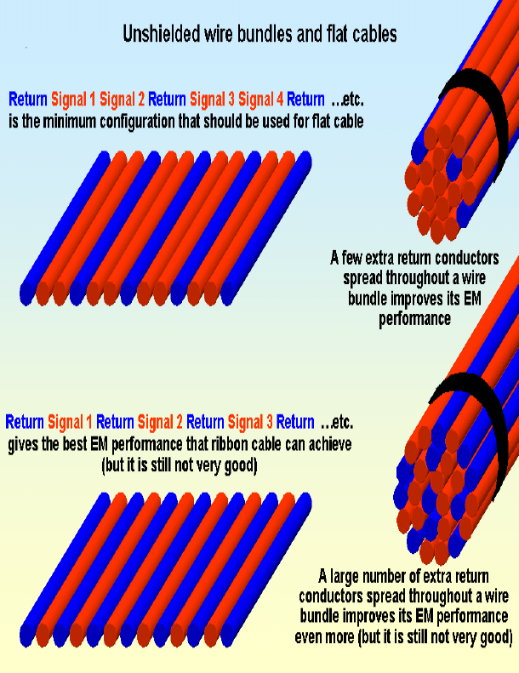
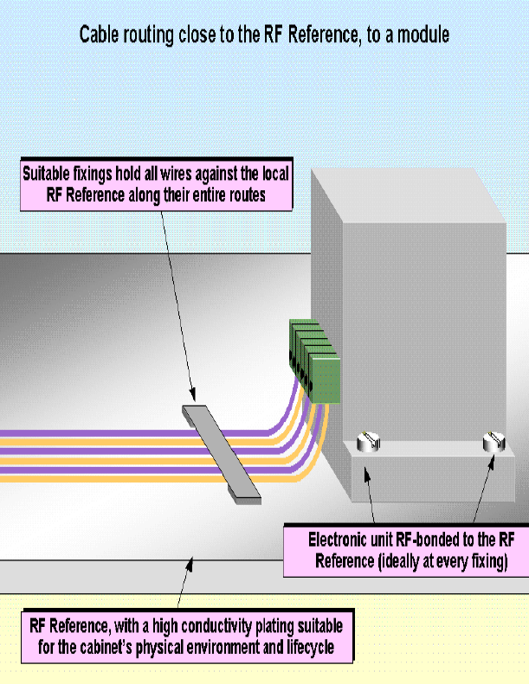
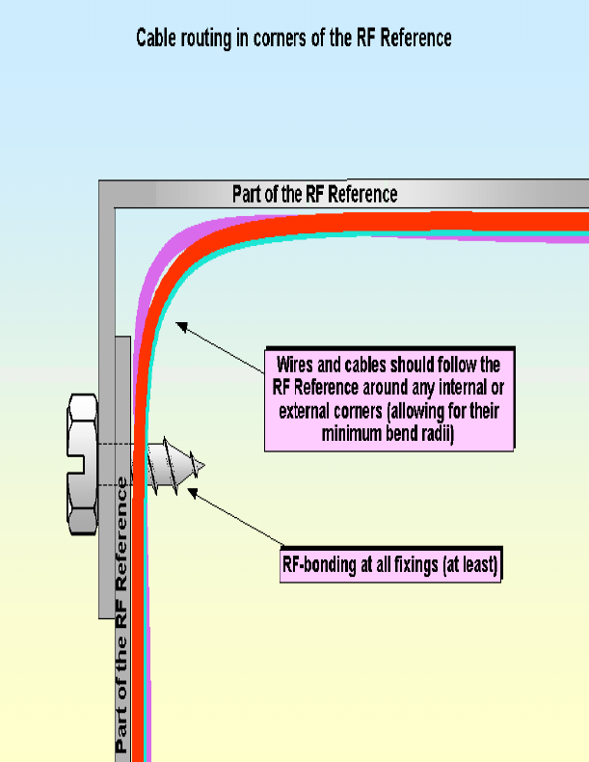
3. Racks
Unshielded cable bundles they should be carefully arrange (multiple return cables)
Cable routing always as close as possible to metallic structures and ground references.
Conductors carrying power or signals should not go too close to the edge of cabinet or rack structure.

Slide 15
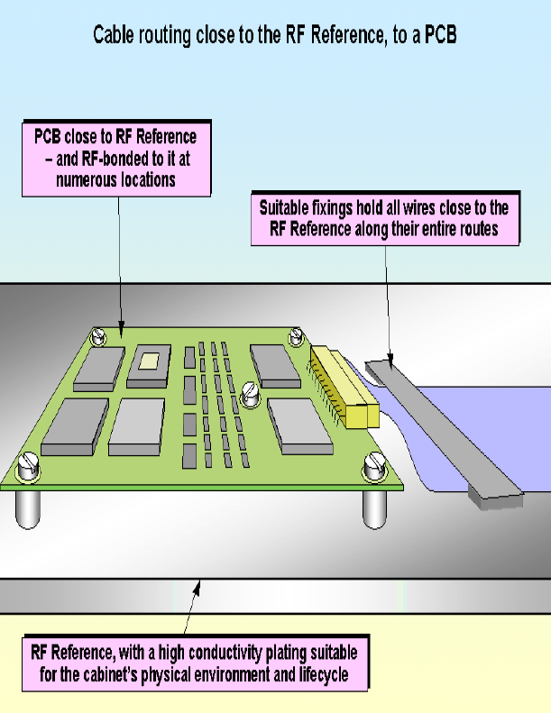
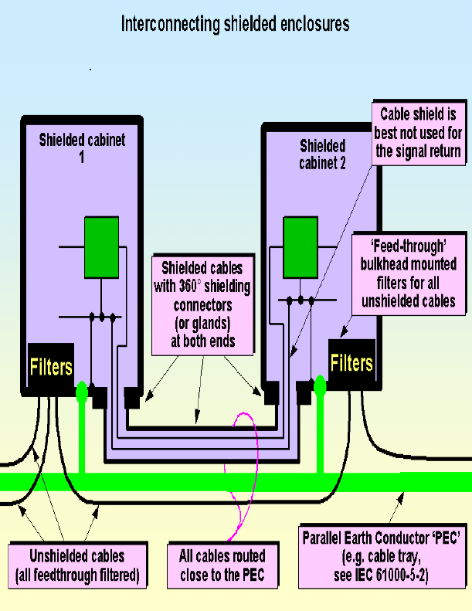
3. Racks
PCB connection to reference ground should be carefully designed
Filter or cable shield should be well connected to cabinet to minimize EMC effects - Entrance
Cabinet doors has to ensure the continuity of the cabinet.
  Copper braid
  This is very important for shielded cabinets

Slide 16
4. Future meetings
Grounding sessions have been a very good opportunity to exchange information and experience among detectors.
  We have to continue with them.
It is planned to have a new big grounding session in the next B2GM – July at VPI,USA
  A grounding review
Main goal:
  Continue system integration
  Fix the project status - Review
A common structure of the grounding status will be prepared by each sub-detector
  We can keep the template used in the past

Slide 17
4. Future meetings
The suggested structure may cover the following aspects:
  Outline of the grounding strategy
    Information about current or previous grounding topology
  Design approach
    Implementation aspects
  Emission and susceptibility issues.
    Analysis of the main noise sources and most susceptible components.
      Identification & test plans
  Shielding aspects, such as cabling layout connections and characteristics, are included in this point.
  Conclusions and a summary of relevant results exposed.
The grounding web-page (not finish yet) will be operational for the meeting (earlier)
  Exchange information

Slide 18
5. Conclusions
Noise issues associated with cabling and racks may be decreased by layout
Attention should be paid in cable and rack layout (small details will help)
  It costs nothing – small details
Good cable classification and rack distribution will help
  Power and noise level
  Proper grounding connections
A new grounding session is planned for the next B2GM meeting – VPI , USA

